Slide 1
IMPORTANT COMMANDS

Slide 2
clc
clear
Ctrl-c
input
disp
fprintf

Slide 3
Clearing the COMMAND Window
Syntax
clc
Description:
clc clears all input and output from the Command Window display, giving you a "clean screen"

Slide 4
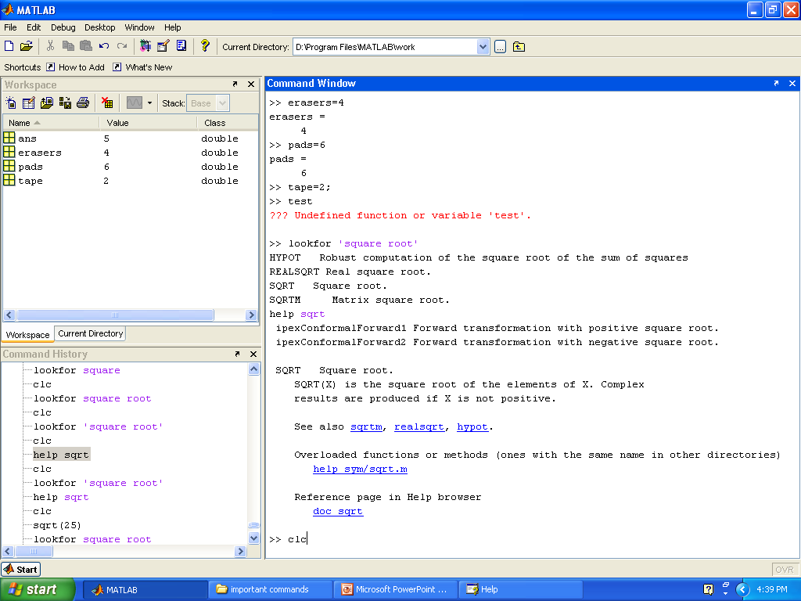
Before clearing
the command window
Enter clc here to
clear the above window

Slide 5
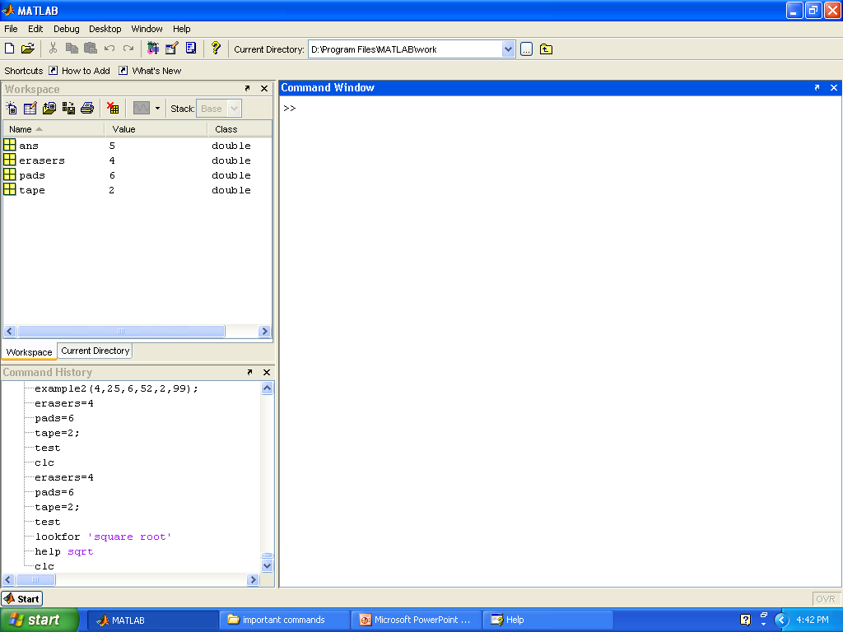
After ‘clc’ the command window appears as shown below
After clc
Before using ‘clear’
the work space is shown

Slide 6
Clearing the Workspace
Syntax
clear
Description:
clear removes all variables from the workspace. This frees up system memory.
clear ‘name’ removes just the M-file or MEX-file function or variable name from the workspace.

Slide 7

Enter clear here to
clear all variables in
the workspace

Slide 8
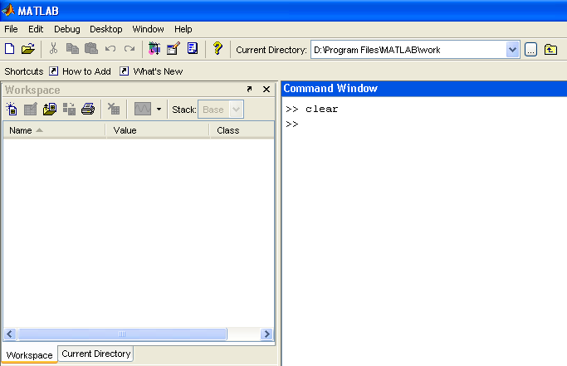
After executing clear Command
After clear function

Slide 9
Up arrow (↑) , Semicolon (;) and Ctrl c
Use the up arrow to recall statements used in the command history.
Use semicolon (;) to suppress the display at the command window.
Ctrl C to terminate the execution

Slide 10
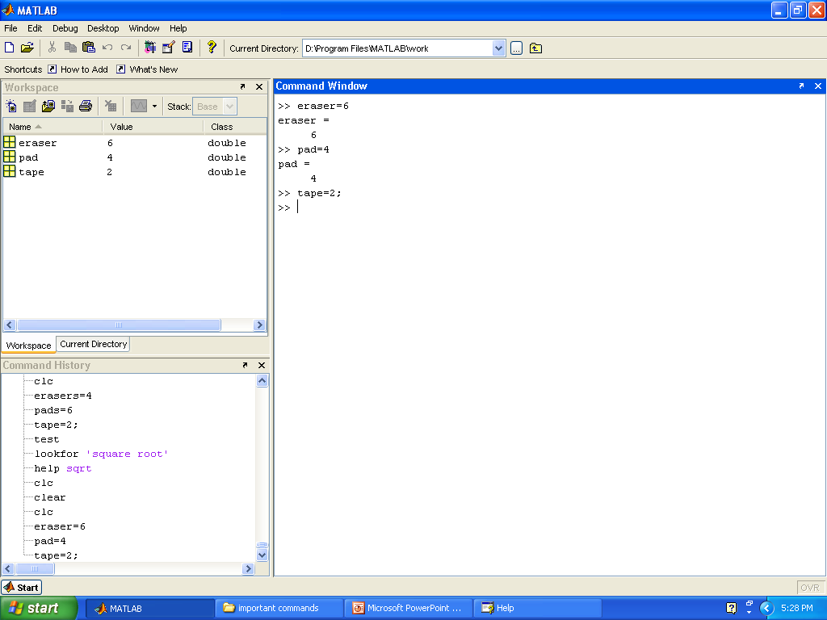
Semicolon ‘;’
Suppress the display

Slide 11
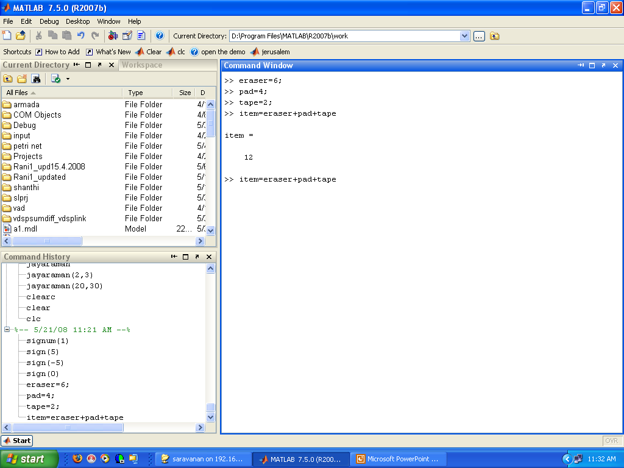
Up arrow to recall statement

Slide 12
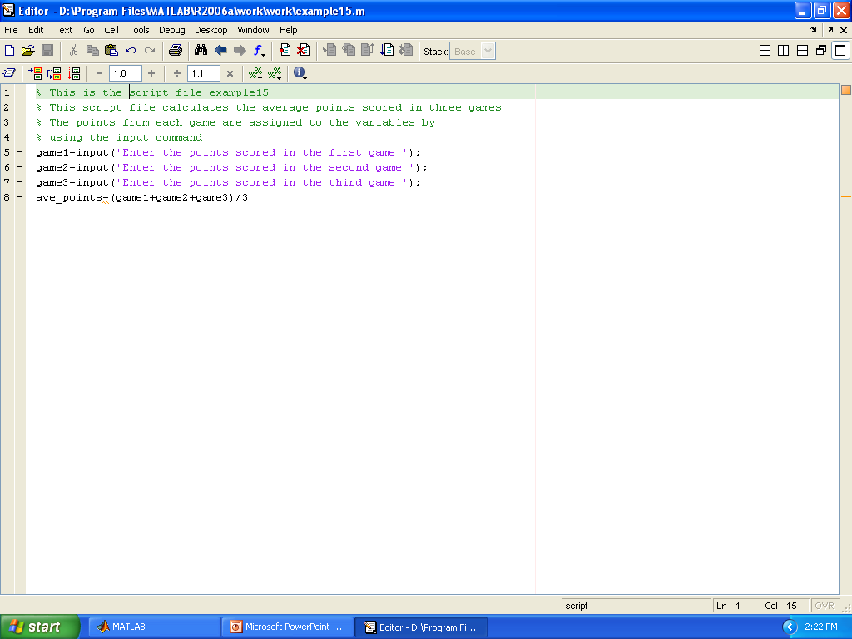
‘input’ command
The variable is defined in the script file and when the file is
executed, the user is prompted to assign a value to the variable
in the command window
Syntax:
Variable_name = input(‘string with a message that is to be displayed in the command window’)
Example:-
Variable_Name

Slide 13
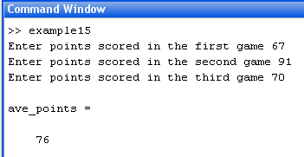
The following shows the command window when the above script file ( saved as example15) is executed

Slide 14
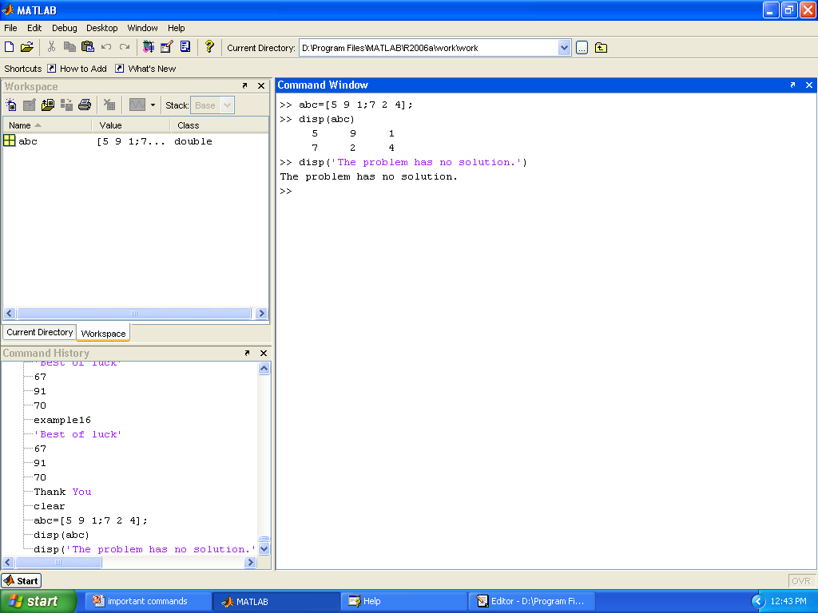
‘disp’ command
The ‘disp’ command is used to display the elements of a variable without displaying the name of the variable.
The format is disp (name of the variable)

Slide 15
‘disp’ text
The format is: disp( ‘text as string’)

Slide 16
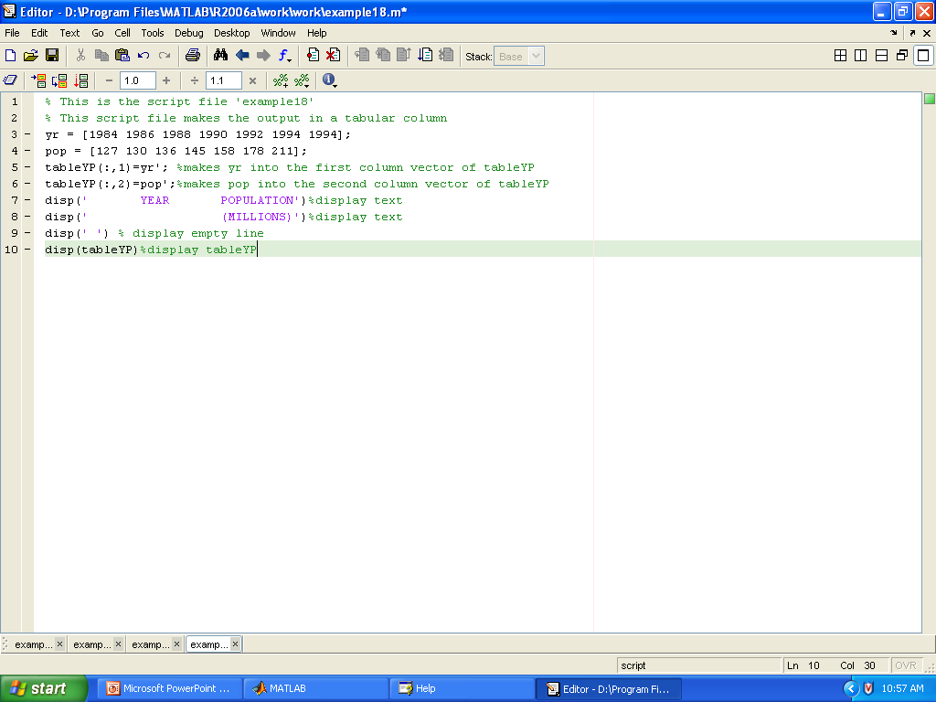
Displaying Output in a Tabular Column

Slide 17
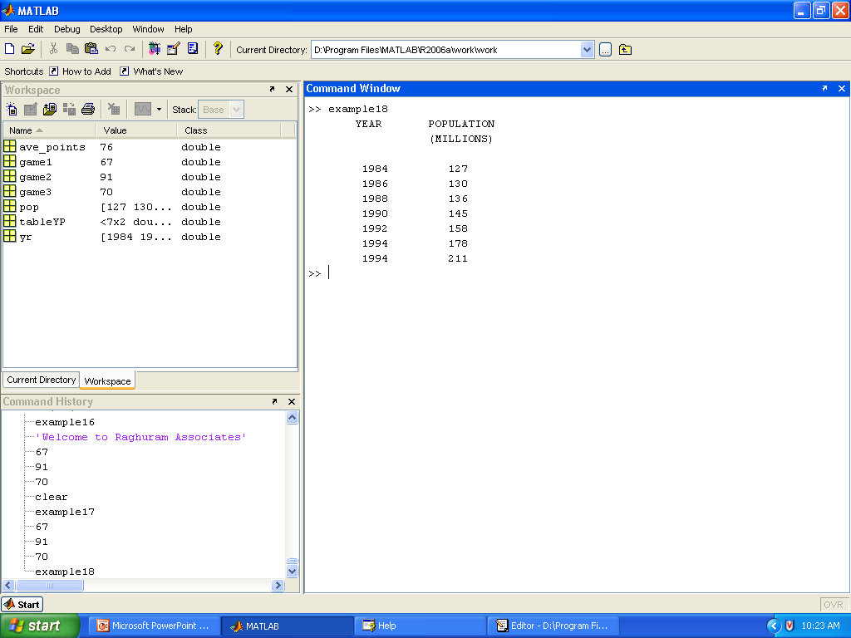
Output as shown below

Slide 18
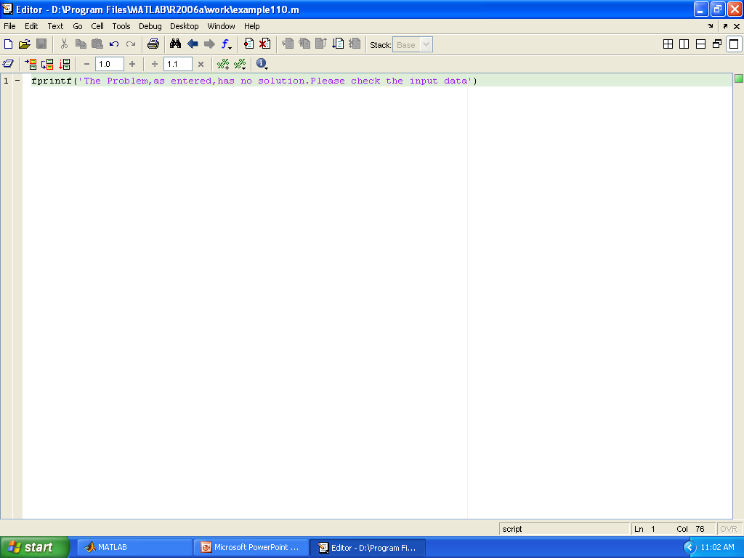
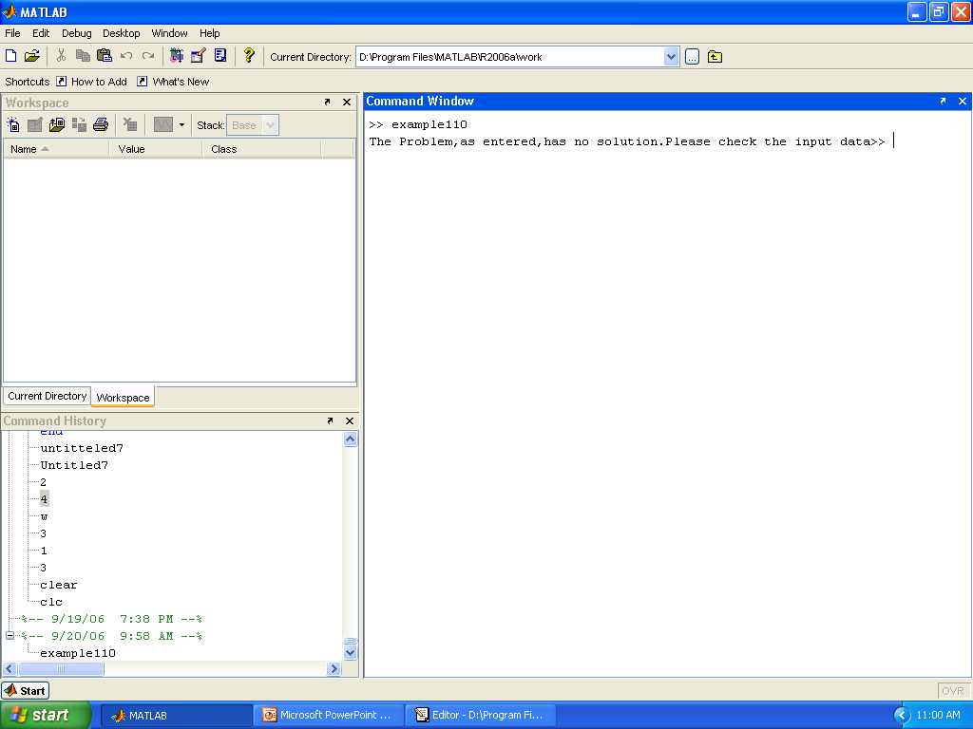
The ‘fprintf’ command
The fprintf command can be used to display output on the screen.
Using the ‘fprintf’ command to display text
Syntax:
fprintf (‘text typed in as a string’)
For example:
Result as shown below in the command window

Slide 19
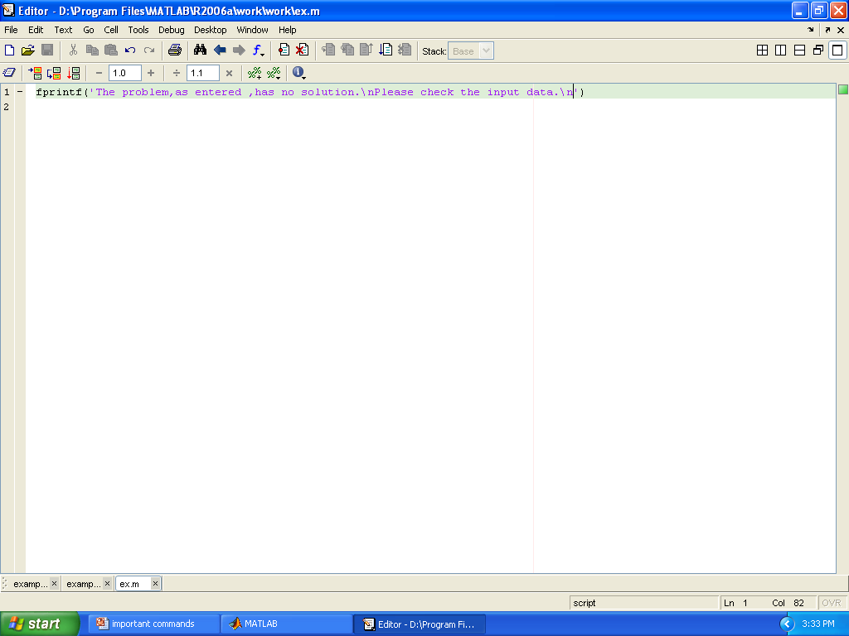
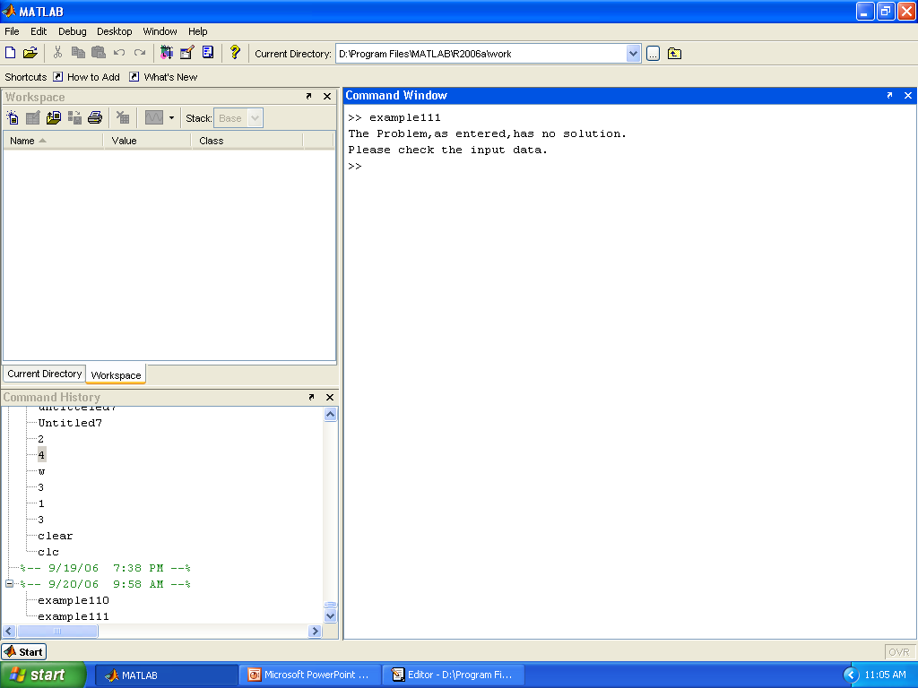
fprintf command with ‘\n’ character
It is possible to start a new line in the middle of the string.
Result as shown below in the command window

Slide 20
‘fprintf’ command to display a mix of text
and numerical data
Syntax:
fprintf (‘text as string %5.2f additional text’, variable name)
Formatting elements
(Define the format of the elements)
Name of the variable
whose value to be inserted
between the text.
% sign marks the spot where
the number is to be inserted
between the text

Slide 21
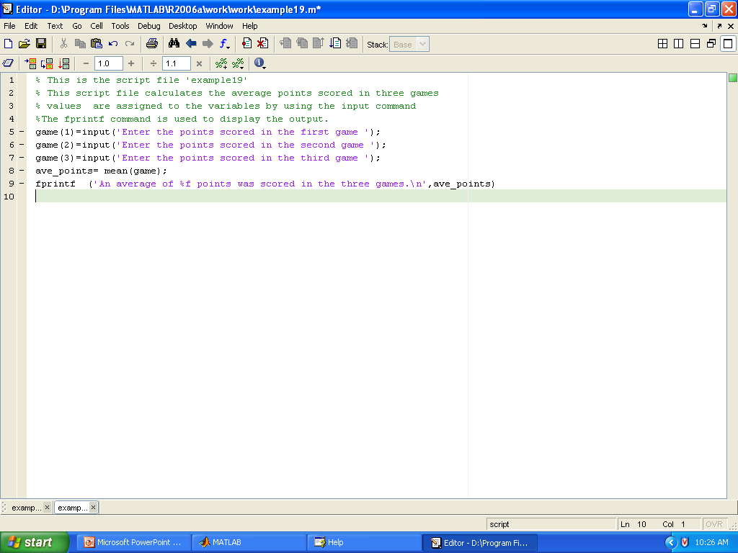
Script file uses the ‘fprintf’
Variable name
Text
% marks the
position of the number
Additional text

Slide 22
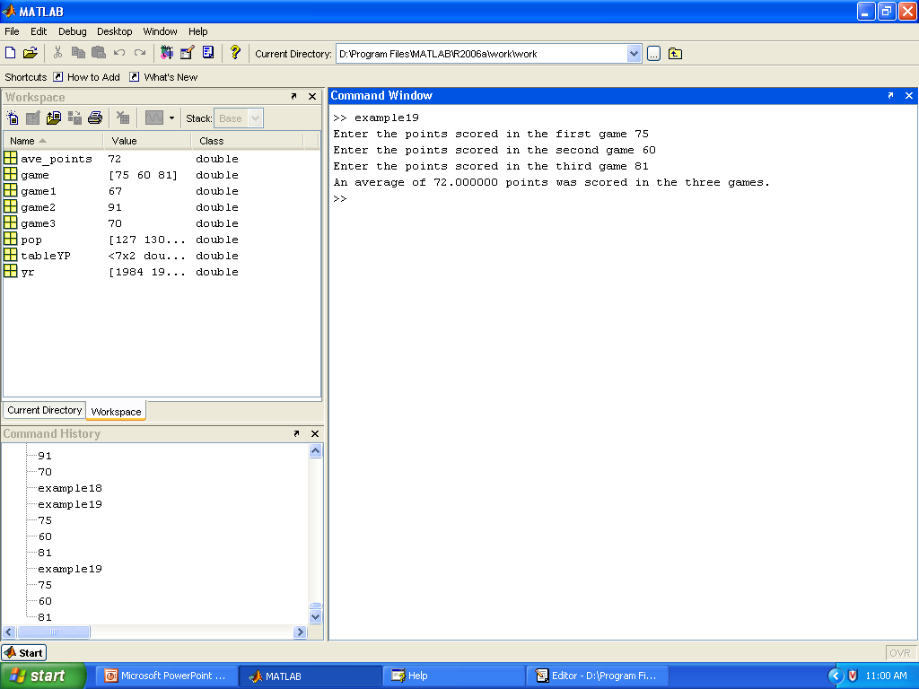
Text with data

Slide 23
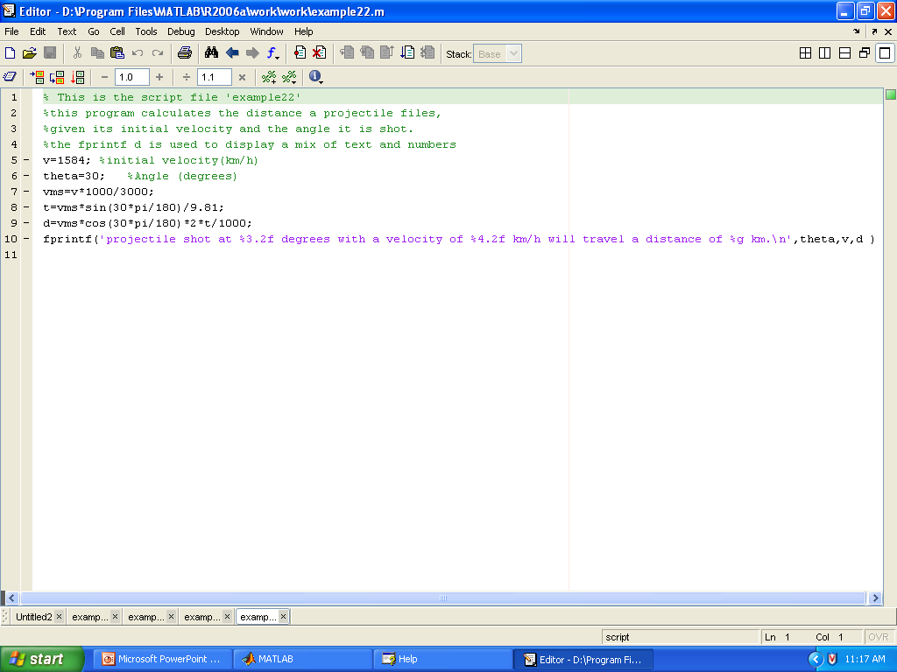
‘fprintf’ command with more than one variable
With this command it is possible to insert more than one
number within the text
Syntax:
fprintf(‘…text….%g…%g…%f…’,var1,var2,var3)

Slide 24
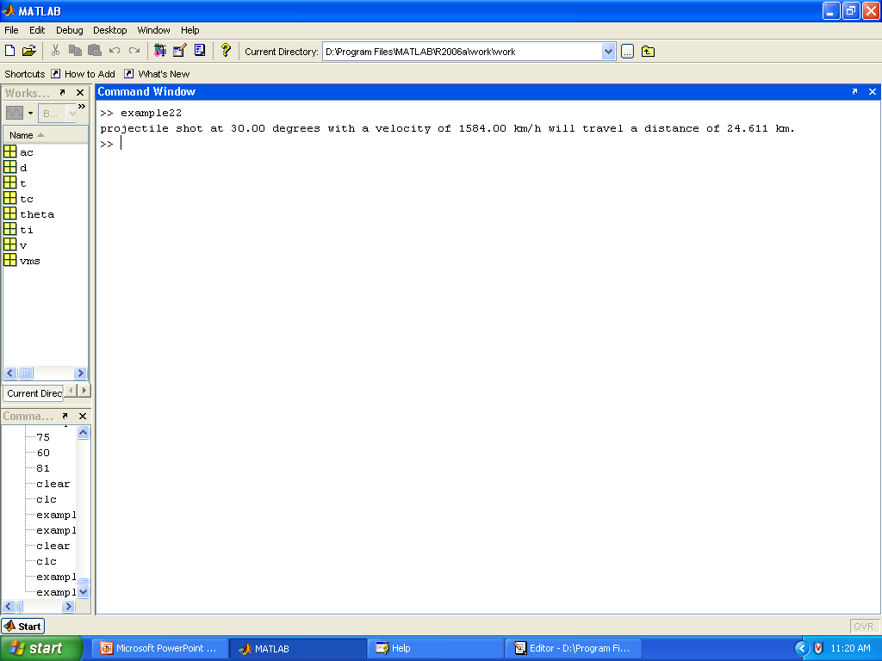
The result as shown below

Slide 25
Other Important Commands
nargin
It returns the number of input arguments specified for a function.
nargout
returns the number of output arguments specified for a function
varargin
Variable length input argument list
The varargin statement is used only inside a function
Find
Finds indices of non zero elements
Size
Returns the size of a variable in terms of its rows and columns
Pack
To consolidate the memory space

Slide 26
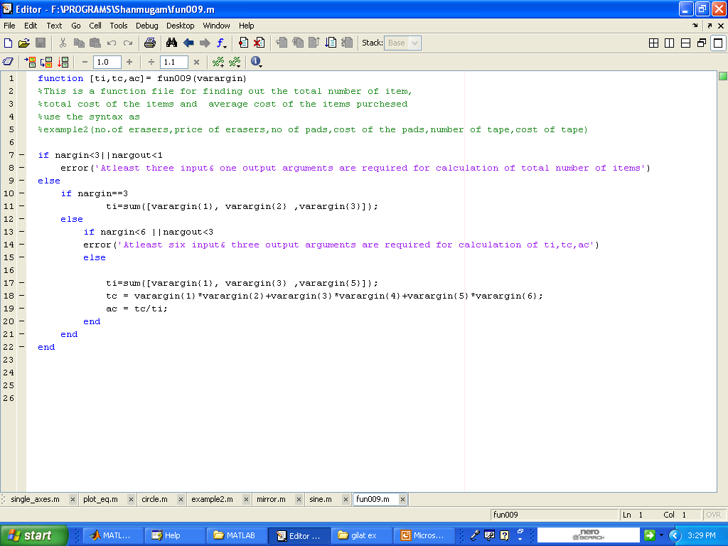
Using ‘varargin’, ‘nargin’, ‘nargout’

Slide 27
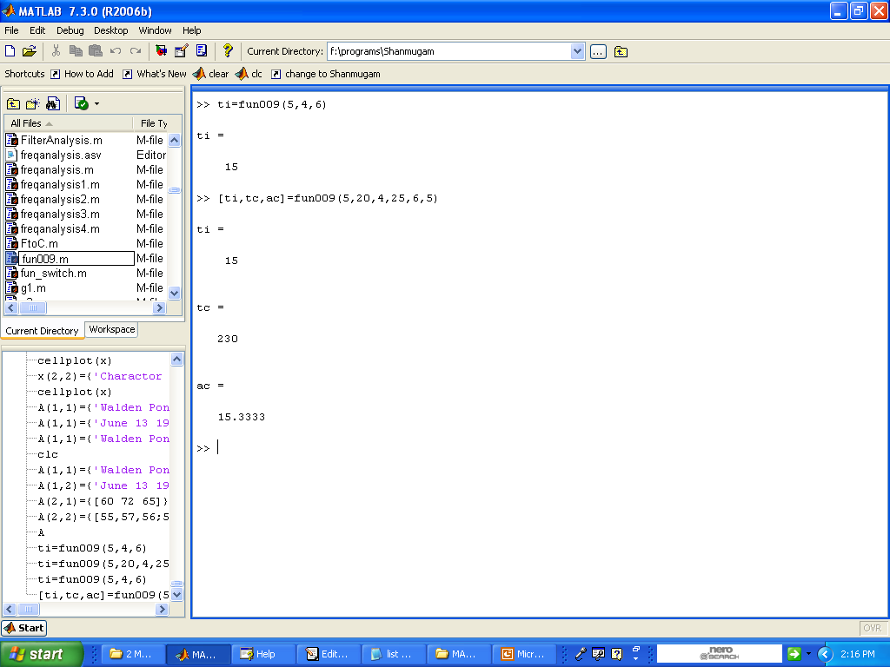
Result

Slide 28
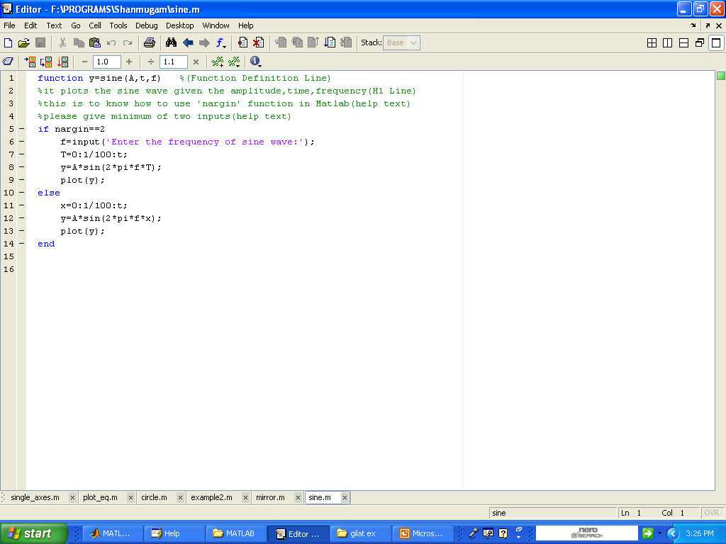
Using ‘nargin’ in function

Slide 29
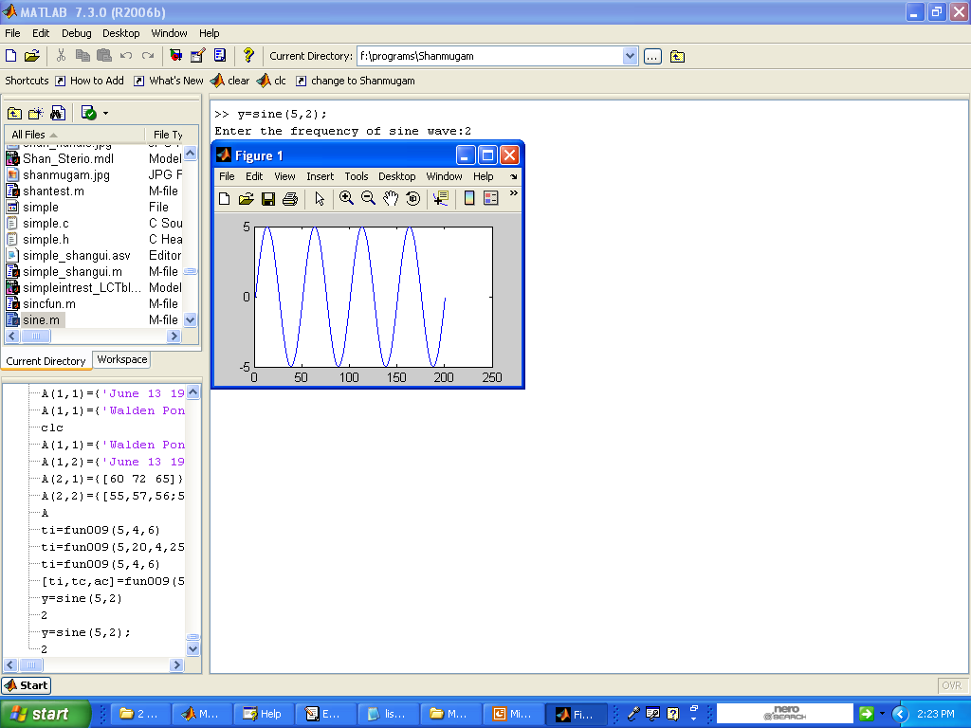
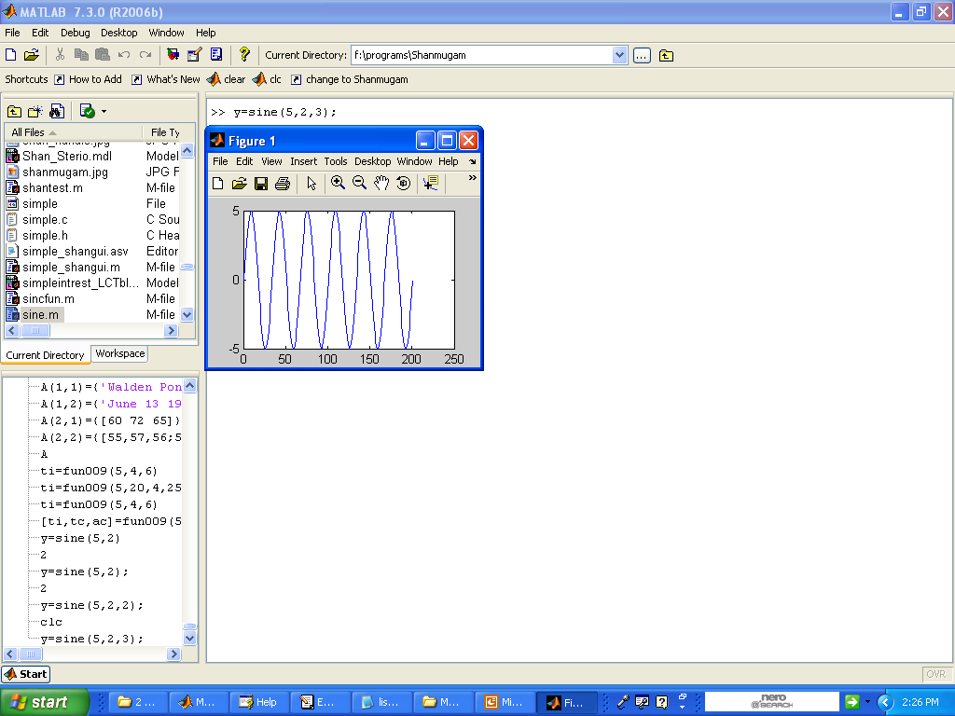
Result

